Slide 1
Hotel Reviews
A Sentimental Analysis
Vivek Menon Komattil & Priya Singh

Slide 2
Reviews & Its Importance
Online reviews are increasingly becoming popular in the business world across the globe while making purchase decisions. A review is a customers feedback for the products or services he has availed. It's estimated that 90% people first check online reviews of which 88% take reviews as personal recommendations. The trust customers put in strangers reviews is forcing business to take online reviews seriously. It has been found that 31% customers are willing to spend more on business that score high on positive reviews.

Slide 3
Reviews : Importance in Hotel Industry
Hospitality industry in increasingly relying on reviews to generate business. With a recent survey indicating that 93% find hotel reviews helpful while booking and with 53% customers saying that they wouldn't book before reading reviews; its essential for hotels to focus on customer reviews. While the focus is on positive reviews ; the response to bad reviews also help business. 79% of the guests have indicated that feel reassured when hotel management make a good response to a bad review.

Slide 4
Project & Dataset
Data scraped from booking.com is used to perform an sentimental analysis of 1493 luxury hotels across European region. The data set consists of 500K reviews from European hotels.The aim of the project is to analyze the sentiments of the customers to gain meaningful insights into trends, patterns and themes of hotel industry in European region.

Slide 5
Data Overview
The dataset consists of 500K rows consisting of the following 17 variables.
Variables | Description
Hotel Address | Address of the Hotel
Review Date | The date the reivew was posted
Average Score | Average score of the hotel
Hotel Name | Name of the Hotel
Reviewer Nationality | Nationality of the reviewer
Negative Review | The negative review given to the hotel
Review Total Negative Word Counts | Total number of words in the negative review
Positive Review | The positive review given to the hotel
Review Total Positive Word Counts | Total number of words in the positive review
Reviewer Score | The rating given by reviewer
Total Number Of Reviews Reviewer Has Given | Number of reviews the user has given in the past
Total Number Of Reviews | Total Number of reivews for the hotel
Tags | Tags given by reviwer to the hotel
Days Since Review | Days passed since the review was made
Additional Number of Scoring | Number of guets who made a scoring rather than a reiew
Lat | Latitude of the hotel
Lng | Longtitiude of the hotel

Slide 6
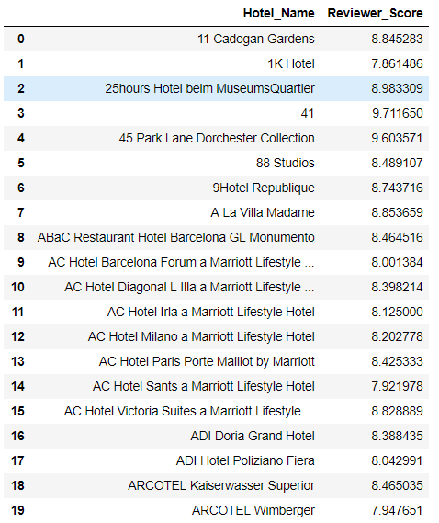
Descriptive analysis
Top 20 hotels with the highest reviewer score.

Slide 7
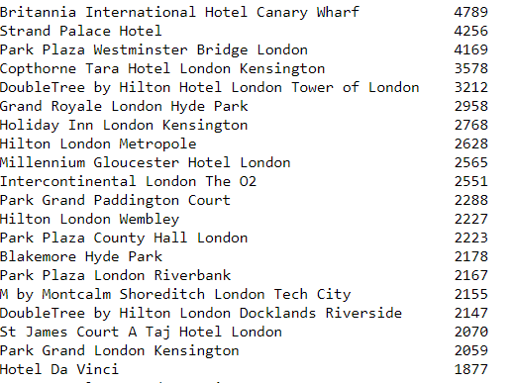
Descriptive analysis
Top 20 hotel with highest number of reviews

Slide 8
Overview of the Analysis Steps
Data Cleaning
Tokenization
Feature Extraction
Training & Testing Data
Algorithms -
Naive Bayes Classifier
Random Forest

Slide 9
Data Cleaning
Removed punctuations - Converting a sentence into list of words, removed stopwords, lemmatization/stemming transforming any form of a word to its root word.
Convert the text into lowercase.
Tokenized the reviews text.
Removed no negative and no positive from the reviews text.
Remove stop words.

Slide 10
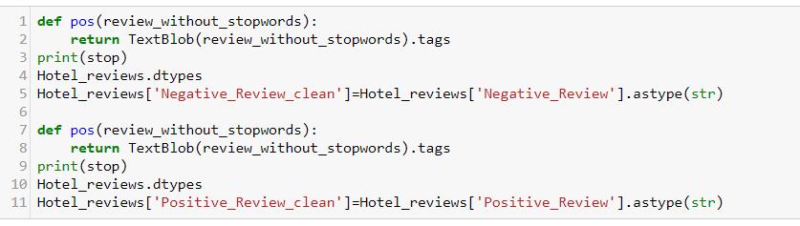
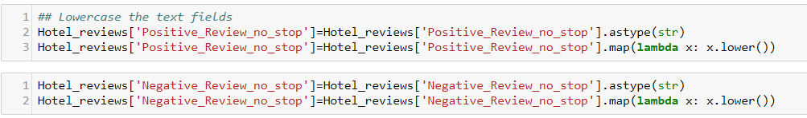
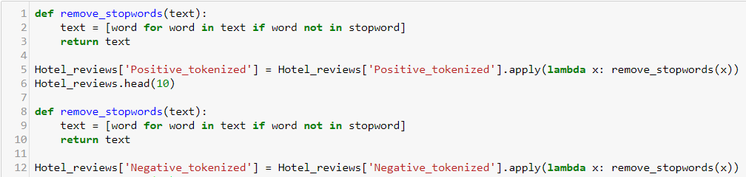
Data Cleaning Code

Slide 11
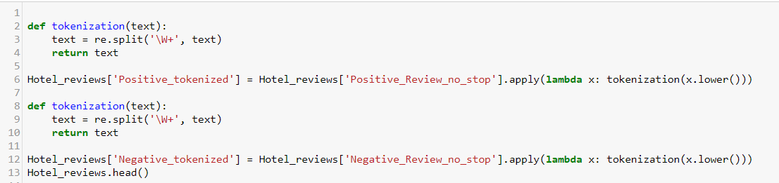
Tokenization
The Hotel review dataset is tokenized to convert big quantities of text into smaller parts to extract words, keywords, phrases and other properties of data for further analysis.

Slide 12
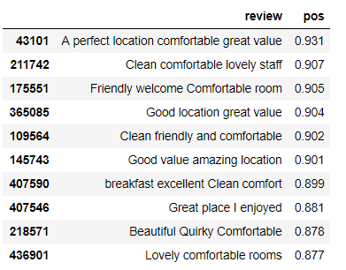
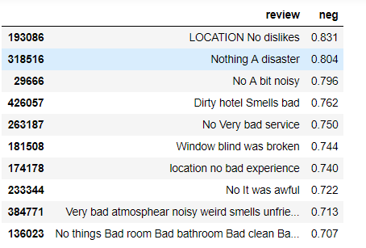
Positive & Negative Sentences
Analyzed the positive and negative score of negative and negative reviews by using sentiments analyzer.

Slide 13
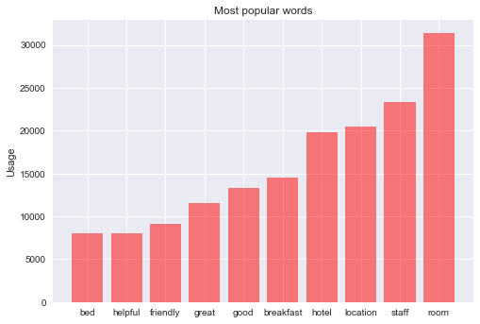
Most popular words
The three most popular words used in hotel reviews are :
Room
Staff
Location

Slide 14
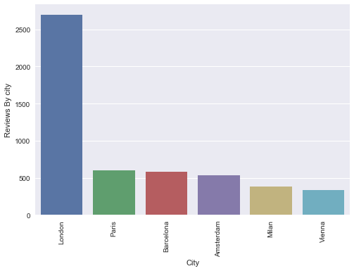
Reviews By City
The most reviewed hotels are from London followed by Paris, Barcelona and Amsterdam.

Slide 15
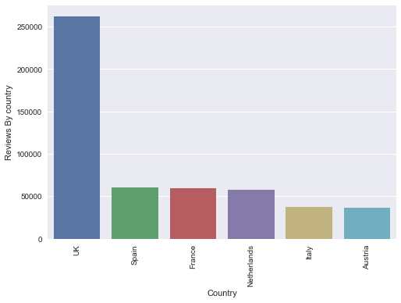
Reviews by Country
The most reviewed hotels are from London followed by United Kingdom, Spain, France and Netherlands.

Slide 16
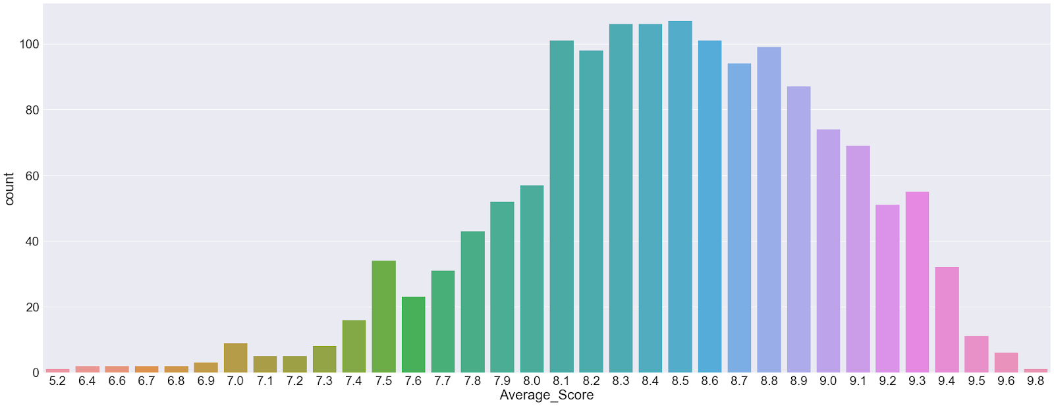
Average score distribution
The most of the average score lies between 8.1 to 8.8

Slide 17
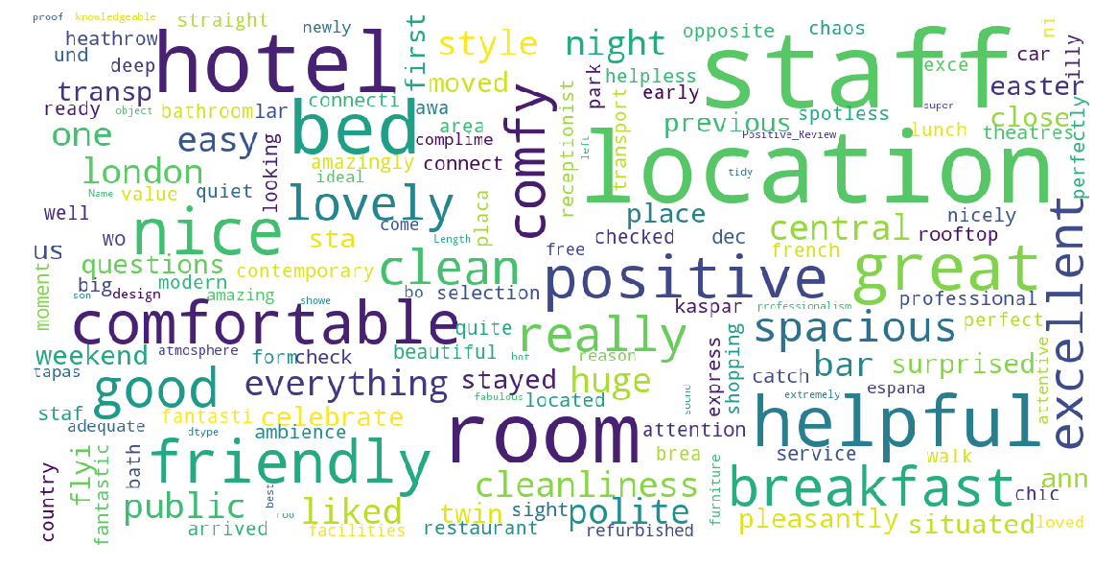
Positive Word Cloud

Slide 18
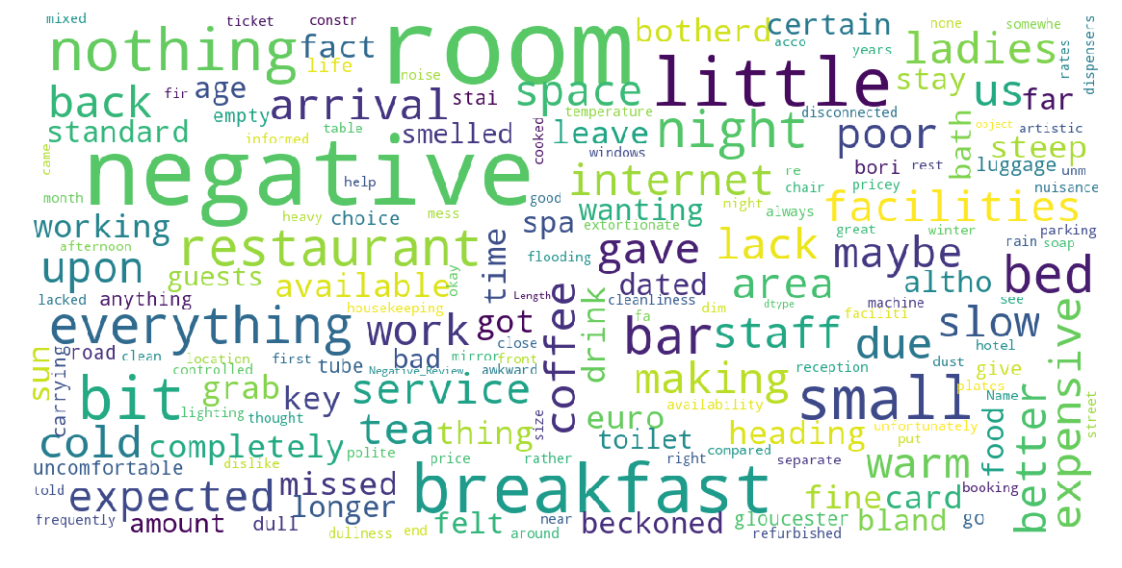
Negative Word Cloud

Slide 19
Feature Extraction
The below table lists the the most important characteristics and features of the dataset extracted using Random Forest.
Features | Score
Compound | 0.231957
nb_chars | 0.21872
neu | 0.142803
nb_words | 0.139981
neg | 0.138391
pos | 0.128148

Slide 20
Naive Bayes Classifier
Naive Bayes is a simple, effective and commonly-used, machine learning classifier. It is a probabilistic classifier and are popularly used for text classification, and for problems such as spam detection.

Slide 21
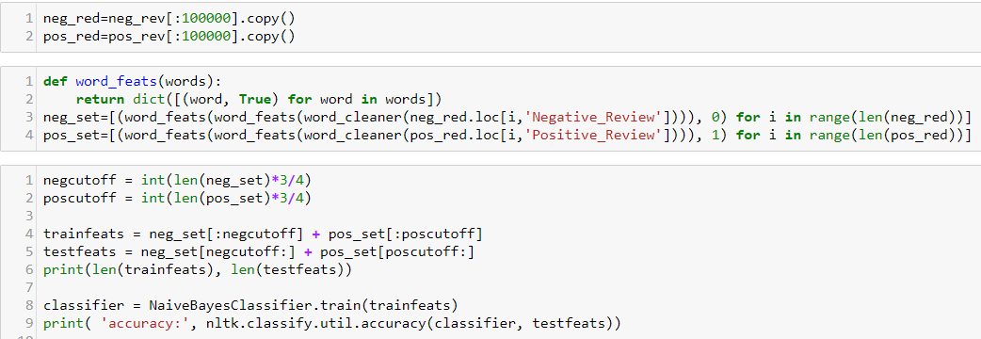
Naive Bayes Classifier Accuracy : 89%

Slide 22
Conclusion
London is the most popular city in reviews.
United Kingdom is the most popular country in reviews.
The top 3 reviewed hotels are in London.
Britannia International Hotel, Canary Wharf is the most reviewed hotel.
Room, Staff and Location are the most popular words in positive reviews.
Naïve Bayes accuracy is 89%.
The average review score lies between 8.1 to 9.

